Slide 1
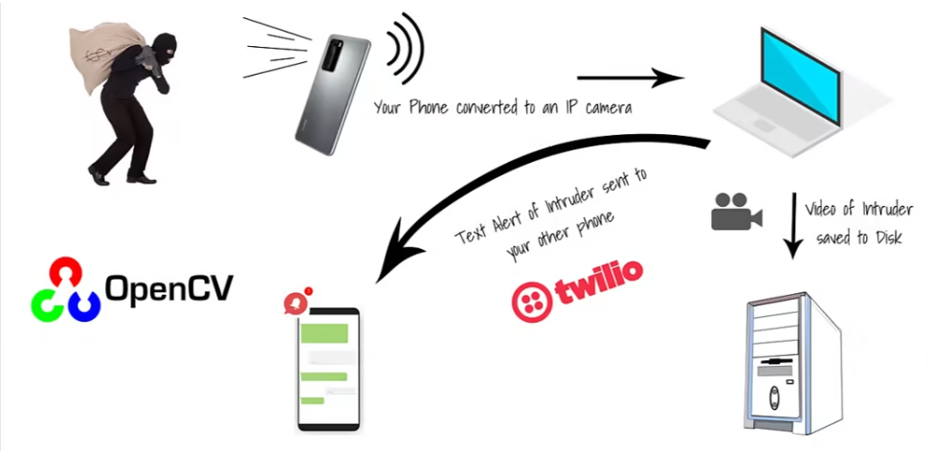
Vishwakarma Institute of Technology, Pune
Third Year Electronic and Telecommunication
Automated Intrusion Detection System Using Mobile phone and computer vision
Under the Guidance of : Prof. S.B.Bhorge

Slide 2
GROUP MEMBERS
Roll No. | Name | GR. No.
59 | Swapnil Patil | 12120131
75 | Devyani Ushir | 12120175
77 | Saburi Waghmare | 12120207
78 | Sakshi Bhosale | 11910725

Slide 3
PROBLEM STATEMENT
INTRODUCTION
OBJECTIVE
LITERATURE SURVEY
BLOCK DIAGRAM
METHODOLOGY
CONCLUSION
REFERENCE
CONTENTS

Slide 4
PROBLEM STATEMENT :
Traditional home security systems may have limitations, such as requiring expensive
equipment, complex installation processes, and high monthly fees. Additionally, many
security systems rely on manual monitoring or pre-set schedules, which can lead to .
missed alerts or false alarms.
As a result, there is a need for a more efficient and cost-effective solution for
detecting intruders in homes.

Slide 5
INTRODUCTION :
Automated Intrusion Detection System (AIDS) uses mobile phones and computer vision to enhance security in homes, offices, and public places.
It employs computer vision algorithms to detect and recognize human activities captured by mobile phones.
The system analyzes the video footage to identify and detect anomalous activities that may pose a security threat.
It can be applied in various security scenarios, including detecting intruders, preventing theft, and monitoring suspicious activities.

Slide 6
OBJECTIVE :
Enhance security measures: The primary objective of this technology is to improve security measures in various settings such as homes, offices, and public places by detecting and recognizing human activities that may pose a security threat.
Real-time detection: The system is designed to provide real-time detection of anomalous activities using computer vision algorithms. This feature allows security personnel to respond promptly to potential security breaches and minimize the impact of the breach.
Cost-effective solution: The use of mobile phones as the primary device for video capture makes this technology a cost-effective solution for security surveillance. It eliminates the need for expensive equipment and reduces the cost of setting up and maintaining a security system.
Easy to install and use: The system is designed to be easy to install and use, making it accessible to a wider audience. With minimal training, security personnel and end-users can operate and maintain the system effectively.
Continuous learning and improvement: The system is programmed to learn from previous instances of abnormal activities, making it more accurate and effective in detecting security breaches over time. This feature ensures that the system continues to improve and adapt to changing security threats.

Slide 7
LITERATURE SURVEY

Slide 8
SR.No. | Paper Title | Published By/ Year | Author | Summary
1 | Survey on SDN based network intrusion detection system using machine learning approaches | 2018 Published By Springer | Nasrin Sultana , Naveen Chilamkurti1 | Nasrin Sultana et al. reviews recent works and discusses ongoing challenges in implementing NIDS using ML/DL. This paper examined the emerging field of Software-Defined Networking (SDN) and outlined various intrusion detections mechanisms using ML/DL approaches. Deep learning has gained importance due to its efficiency in evaluating network security, and various issues need to be considered while implementing NIDS. Developing a feature selection method with classifiers is an ongoing challenge. To design a centralized SDN controller, real-time intrusion detection in high-speed networks is a possible future direction. This survey could help R&D people understand the development of NIDS in SDN context using DL approach.
2 | Smart Border Surveillance System using Wireless Sensor Network and Computer Vision | 2019 Published By IEEE | Neha Bhadwal , Vishu Madaan | Neha Bhadwal et al. finds Border surveillance is an important task in national defense and security, as it is necessary to maintain peace and ensure safety of a country's people. Currently, this monitoring is done manually by the border security forces, which takes a lot of manpower and assets. The need is to design an automated border surveillance system which can perform the surveillance task without requiring any human assistance. Central control rooms can be set up at a distance from the border area, and such systems can save resources and reduce the risk to human life. However, complete automation of border surveillance is not yet attainable due to safety constraints. The smart border surveillance system can help enhance the security of border areas and save labor and assets by using advanced technology. It can also help control unwanted and suspicious activities in a better and accurate way.

Slide 9
SR.No. | Paper Title | Published By/ Year | Author | Summary
3 | Intrusion detection system: A comprehensive review | 2012 Published By Elsevier Ltd. | Hung-Jen Liao a , Chun-Hung Richard Lin a,n | Richard Lin et al researches Current IDSs pose challenges due to capricious intrusion categories and computational power, so this study proposes a taxonomy to outline modern IDSs. The study of intrusion detection systems (IDSs) has received a lot of attention due to the increasing amount of network throughput and security threat. Each technique has its superiority and limitations, so it is important to be cautious about selecting the approaches. Heuristic-based approaches have the merit of no prior knowledge of attacks, but do not work well in real-time applications due to the high computational complexity. To provide a comprehensive view of IDSs and application requirements, the authors propose a taxonomy to outline modern IDSs, tables and figures to easily grasp the overall picture, and two famous and open source tools for studying IDSs.
4 | Anomaly-based intrusion detection system through feature selection analysis and building hybrid efficient model | 2017 Published By Elsevier B.V. | Shadi Aljawarneha,∗, Monther Aldwairi a,b | Shadi et al. develops a new hybrid model that can be used to estimate the intrusion scope threshold degree based on the network transaction data's optimal features. The experimental results revealed that the hybrid approach had a significant effect on the minimization of the computational and time complexity involved when determining the feature association impact scale. However, there are issues with obtaining high false and low false negative rates. The hybrid algorithm consists of J48, Meta Paging, Random Tree, REPTree, AdaBoostM1, Decision Stump and Naïve Bayes, and improved accuracy, high false negative rate, and low false positive rule The NSL-KDD dataset has been used to test and simulate IDS performance, and the proposed hybrid model reduces the accuracy rate and detection time.

Slide 10
SR.No. | Paper Title | Published By/ Year | Author | Summary
5 | INTRUSION DETECTION IN WIRELESS AD HOC NETWORKS | 2004 Published By IEEE | AMITABH MISHRA, KETAN NADKARNI | Amitabh Mishra et al. researches that Intrusion detection has become increasingly important in network security, especially in wireless ad hoc networks, which are vulnerable to attacks. Intrusion detection systems (IDSs) monitor audit data, look for intrusions, and initiate a proper response. This article presents a survey on the work that has been done in the area of intrusion detection in mobile ad hoc networks. Intrusion detection and response for wireless ad hoc networks is a recent development, requiring resource-constrained approaches that require analysis of large trace data or attack signatures. Anomaly-detection-based schemes are more applicable, requiring less modification of routing protocols and allowing trace analysis and anomaly detection to be performed locally in each node.
6 | Towards an Intrusion Detection System for Battery Exhaustion Attacks on Mobile Computing Devices | 2005 Published By IEEE | Daniel C. Nash, Thomas L | Daniel C. Nash, & Thomas L developes An intrusion detection system uses a linear regression model to estimate power consumption and identify potential battery exhaustion attacks. The proposed IDS was effective in identifying when the system has exceeded the power consumption that would allow it to achieve a guaranteed battery life. System-call delays were used to mitigate the effect of programs suspected as anomalous, and process energy estimation could serve as a first line of defense. An open question is whether an IDS based on self-contained power measurement can be used to detect non-battery-related intrusions.

Slide 11
METHODOLOGY

Slide 12
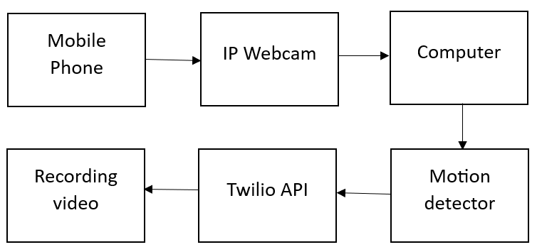
BLOCK DIAGRAM
Notes:
Mobile phone: The mobile phone is used as a primary device for video capture. It captures the video footage of the monitored area and sends it to the computer for analysis.
Wi-Fi Router: The Wi-Fi router is used to establish a wireless connection between the mobile phone and the computer. It enables the mobile phone to transfer the video footage to the computer in real-time.
Computer: The computer is the primary device for image processing and analysis. It receives the video footage from the mobile phone and processes it using OpenCV library. It analyzes the video footage for anomalous activities and identifies potential security threats.
OpenCV library: OpenCV is a popular computer vision library used for image processing and analysis. It provides various functions and algorithms for detecting and recognizing human activities in the video footage.
Intruder detection module: The intruder detection module is responsible for analyzing the video footage and detecting potential security threats. It is implemented using OpenCV library and runs on the computer.
Alarm system: The alarm system is triggered when the intruder detection module detects potential security threats. It alerts the security personnel and/or the end-users about the potential security breach.
Notification system: The notification system is used to send alerts and notifications to the security personnel and/or the end-users about the potential security breach. It can be implemented using various communication channels such as email, SMS, or push notifications.

Slide 13
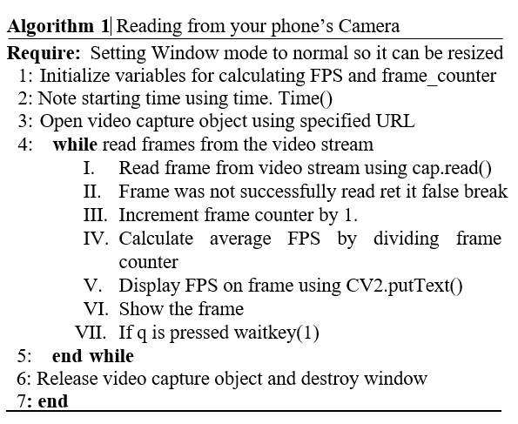
Algorithm for record video from IP Webcam

Slide 14
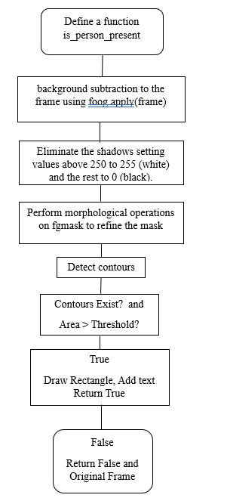
Flow chart for Presence of person

Slide 15
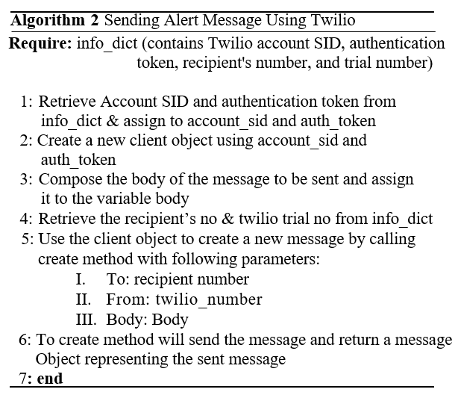
Algorithm for Sending Message

Slide 16
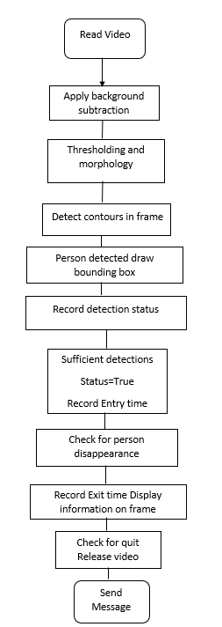
Flow chart for Final Application

Slide 17
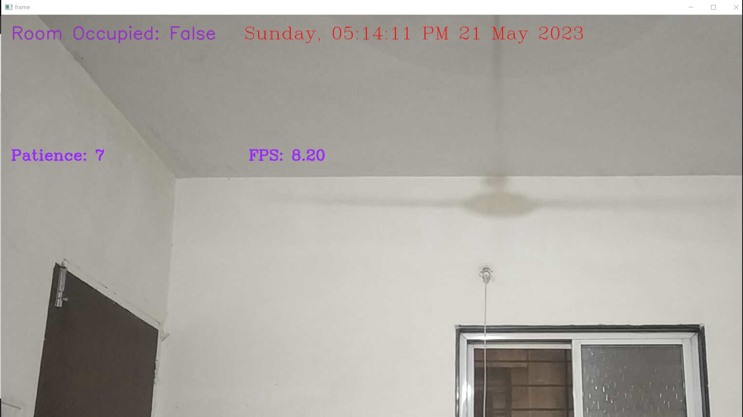
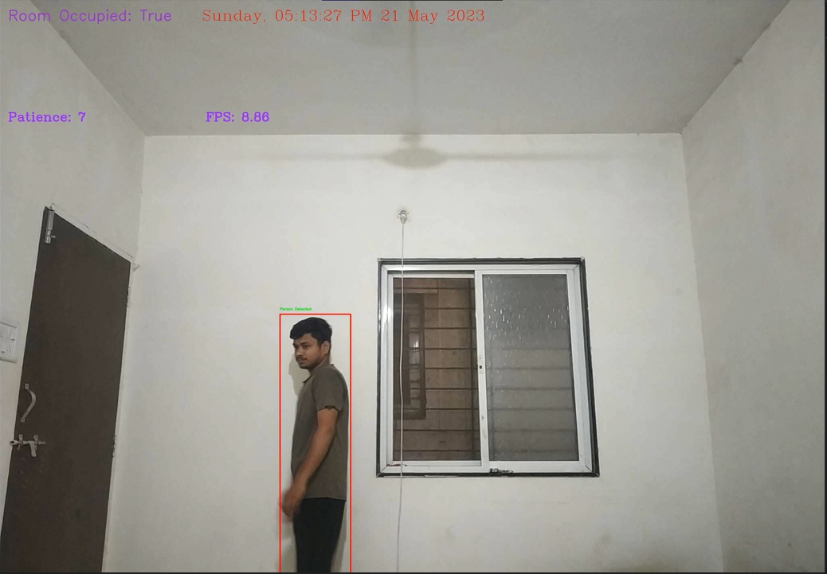
RESULTS
Fig.1. (live stream video of ID system)
Fig.2. (Result for Person is detected )

Slide 18
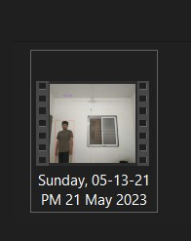

RESULTS
Fig.3. (Video saved in folder)
Fig.4. (Alert message received using Twilio API)

Slide 19
ADVANTAGES
Real-time Threat Detection.
Early Warning System.
Rapid Incident Response.
Behavioral Analysis.

Slide 20
LIMITATIONS
Instead of having a dynamic IP address for your IP Camera, it would be more convenient to set up a static IP. This way, you won't have to change the address every time you launch the camera.
Currently, your IP Camera can only be accessed when your device and PC are connected to the same network or Wi-Fi. To make it accessible globally, you'll need to explore methods for setting up the camera to work across different networks.

Slide 21
In conclusion, the Smart Intruder Detection System with OpenCV and your Phone is a promising technology that can enhance security measures in various settings. This system utilizes the mobile phone as a primary device for video capture and OpenCV library for image processing and analysis.
The system analyzes the video footage for anomalous activities and identifies potential security threats. The intruder detection module triggers the alarm system and notification system when it detects potential security breaches.
This technology is a cost-effective solution for security surveillance, as it eliminates the need for expensive equipment and reduces the cost of setting up and maintaining a security system.
CONCLUSION

Slide 22
References:
[1]. Sultana, N., Chilamkurti, N., Peng, W., & Alhadad, R. (2019). Survey on SDN based network intrusion detection system using machine learning approaches. Peer-to-Peer Networking and Applications, 12, 493-501.
[2]. Bhadwal, N., Madaan, V., Agrawal, P., Shukla, A., & Kakran, A. (2019, April). Smart border surveillance system using wireless sensor network and computer vision. In 2019 international conference on Automation, Computational and Technology Management (ICACTM) (pp. 183-190). IEEE.
[3]. Liao, H. J., Lin, C. H. R., Lin, Y. C., & Tung, K. Y. (2013). Intrusion detection system: A comprehensive review. Journal of Network and Computer Applications, 36(1), 16-24.
[4]. Aljawarneh, S., Aldwairi, M., & Yassein, M. B. (2018). Anomaly-based intrusion detection system through feature selection analysis and building hybrid efficient model. Journal of Computational Science, 25, 152-160.
[5]. Mishra, A., Nadkarni, K., & Patcha, A. (2004). Intrusion detection in wireless ad hoc networks. IEEE wireless communications, 11(1), 48-60.
[6]. Nash, D. C., Martin, T. L., Ha, D. S., & Hsiao, M. S. (2005, March). Towards an intrusion detection system for battery exhaustion attacks on mobile computing devices. In Third IEEE international conference on pervasive computing and communications workshops (pp. 141-145). IEEE.

Slide 23
[7]. Pan, S., Morris, T., & Adhikari, U. (2015). Developing a hybrid intrusion detection system using data mining for power systems. IEEE Transactions on Smart Grid, 6(6), 3104-3113.
[8]. Inayat, Z., Gani, A., Anuar, N. B., Anwar, S., & Khan, M. K. (2017). Cloud-based intrusion detection and response system: open research issues, and solutions. Arabian Journal for Science and Engineering, 42, 399-423.
[9]. Stiawan, D., Abdullah, A. H., & Idris, M. Y. (2010, June). The trends of intrusion prevention system network. In 2010 2nd International Conference on Education Technology and Computer (Vol. 4, pp. V4-217). IEEE.
[10]. Vinayakumar, R., Alazab, M., Soman, K. P., Poornachandran, P., Al-Nemrat, A., & Venkatraman, S. (2019). Deep learning approach for intelligent intrusion detection system. Ieee Access, 7, 41525-41550.

Slide 24
THANK YOU

